Slide 1
The Impact of AI Adoption on
Scientific Surprise in
Academic Research
Ben Heim & Adam Tuchler
University of Chicago | March 2026

Slide 2
Research Question
Does AI adoption causally increase the disciplinary breadth of academic citations?
Approach
Diff-in-diff with continuous treatment across 16 academic fields
Treatment intensity: GPT-3.5 marker word adoption (Kobak et al. 2024)
Treatment event: Release of GPT-4o (November 2024)
Outcome: Shannon entropy of citation field distributions
35,080 papers from OpenAlex (May 2023 – Dec 2025)

Slide 3
Prior Work
Hao et al. (2026, Nature)
AI contracts knowledge extent
Binary classification of AI-augmented papers across 41M articles. Finds AI use reduces the "diameter" of knowledge covered. Focuses on AI as a research method, not LLM-assisted writing specifically.
Algaba et al. (2025, NAACL)
LLMs mirror & amplify citation bias
Analyzes 275K AI-suggested references. LLMs reflect human citation patterns but with a heightened Matthew effect — systematically favoring already highly-cited, high-profile work. Studies what LLMs recommend, not what researchers actually do.
Kusumegi et al. (2025, Science)
LLMs boost output, broaden citations
Diff-in-diff on 2.1M preprints. LLM adopters produce 24–89% more papers and cite more diverse sources (books, younger works). However, research quality declines — sophisticated language masks weaker manuscripts.
Our contribution: causal identification of how LLM availability affects cross-field citation entropy using continuous treatment intensity

Slide 4
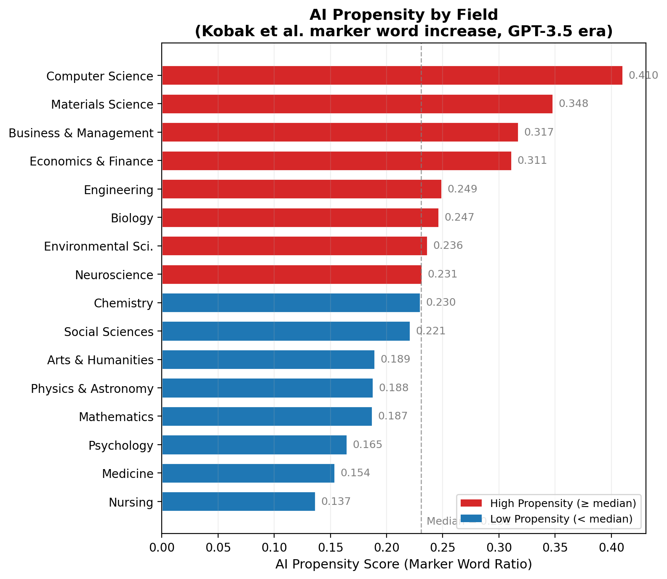
Measuring AI Adoption: Propensity Scores
Increase in Kobak marker word frequency from pre- to post-ChatGPT (GPT-3.5) era

Slide 5
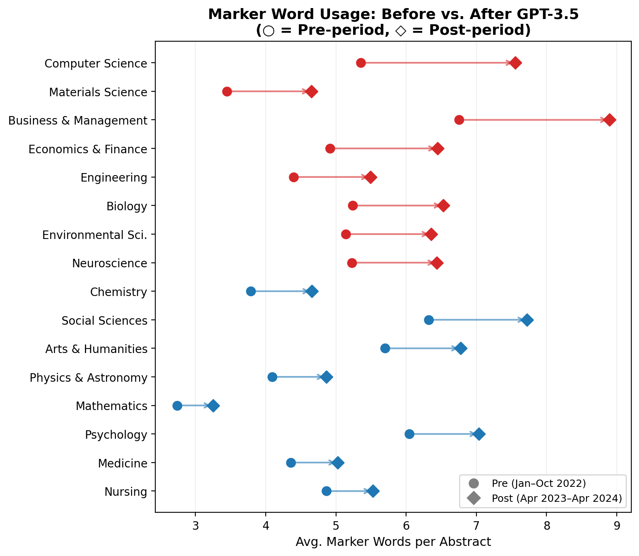
Marker Word Adoption Across Fields
All 16 fields show increases after ChatGPT release, but magnitude varies substantially

Slide 6
Measuring Research Entropy
Hᵢ = – Σ pᵢ(g) · ln pᵢ(g)
where pᵢ(g) = share of paper i's references classified in field g
What it captures
For each paper, we observe where its references land across 26 OpenAlex fields
Shannon entropy measures how spread out that distribution is — capturing both breadth and evenness
Intuition
All citations in one field → H = 0 nats (minimum diversity)
Equal citations across all 26 fields → H = ln(26) ≈ 3.26 nats (maximum diversity)
Why Shannon entropy?
Unlike a simple count of distinct fields, entropy penalizes token citations — a paper citing 95% within its own field and 1% in five others scores much lower than one engaging evenly across six fields

Slide 7
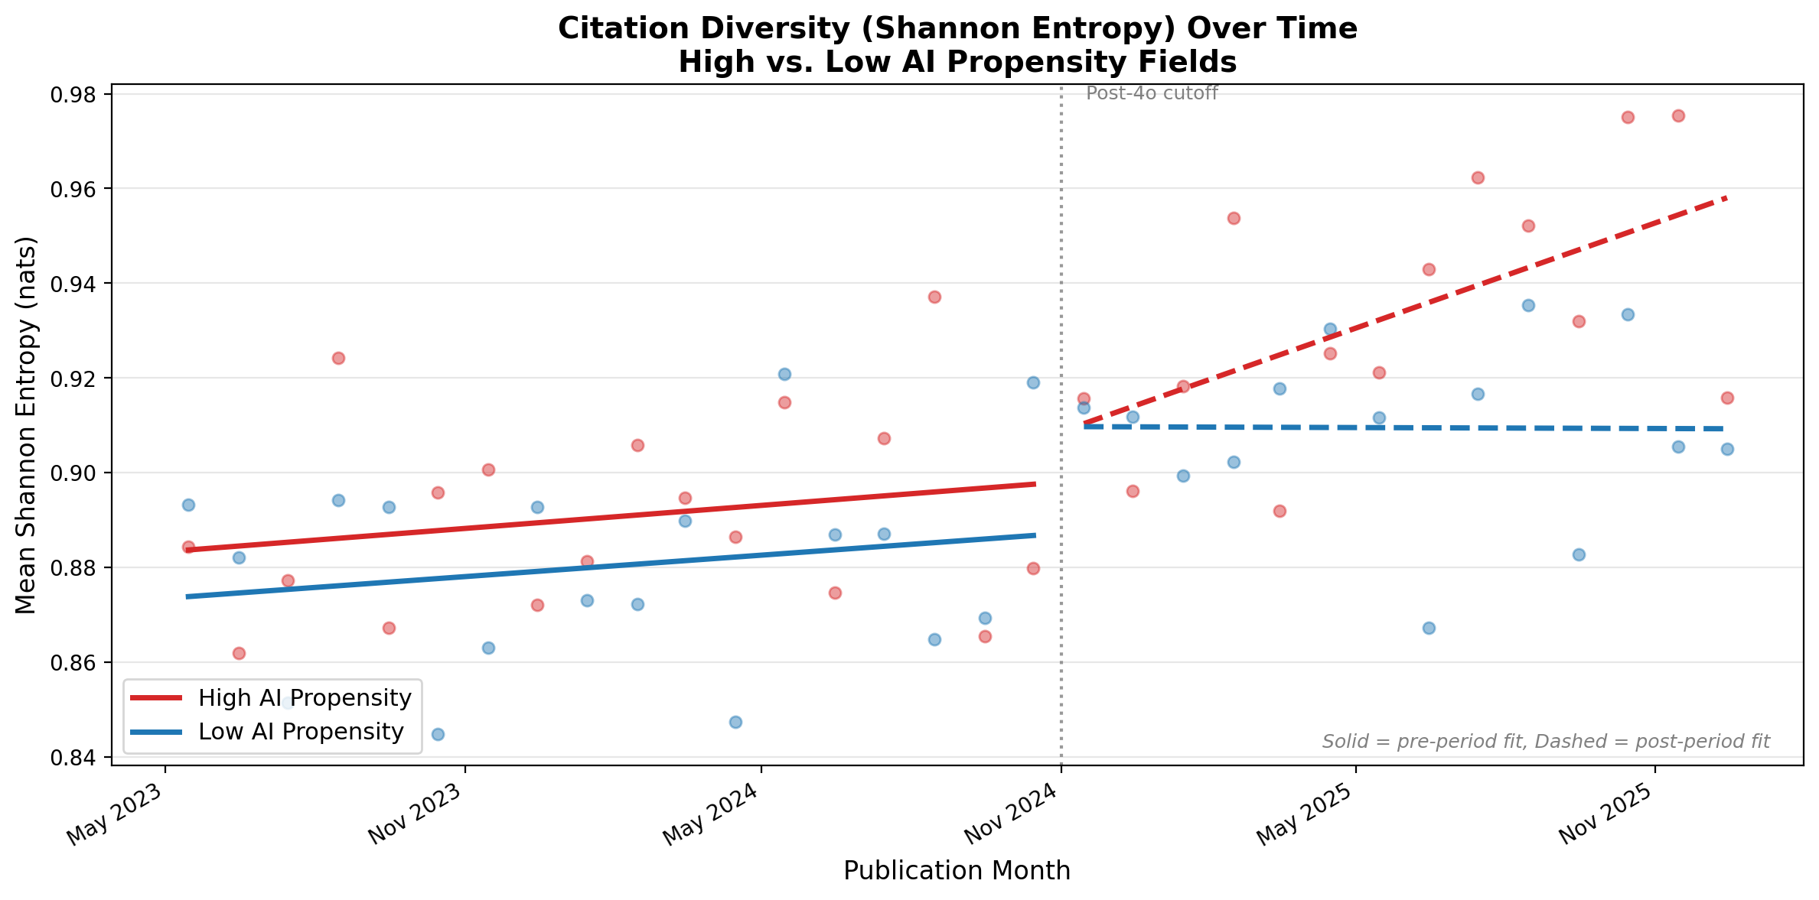
Main Result: Citation Entropy Diverges Post-4o
High-propensity fields show steeper entropy increase after GPT-4o release

Slide 8
Regression Results: Shannon Entropy
Yᵢ = α + β₁(A_f × D_t) + β₂(A_f × T_t) + γ′X + δ_f + θ_t + ε
 | (1) Level | (2) Trend
A_f × D_t (β₁) | 0.170*** | –0.044
 | (0.068) | (0.106)
A_f × T_t (β₂) |  | 0.031***
 |  | (0.012)
Num. authors | 0.001 | 0.001
Distinct institutions | –0.000*** | –0.000***
Distinct countries | 0.015*** | 0.015***
Field FE | Yes | Yes
Year-month FE | Yes | Yes
N | 35,080 | 35,080
R² | 0.143 | 0.143
Column (1): significant level shift. Column (2): level shift absorbed by gradual trend — consistent with AI diffusion, not an instantaneous shock.
HC1 robust standard errors in parentheses. *** p < 0.01, ** p < 0.05, * p < 0.10

Slide 9
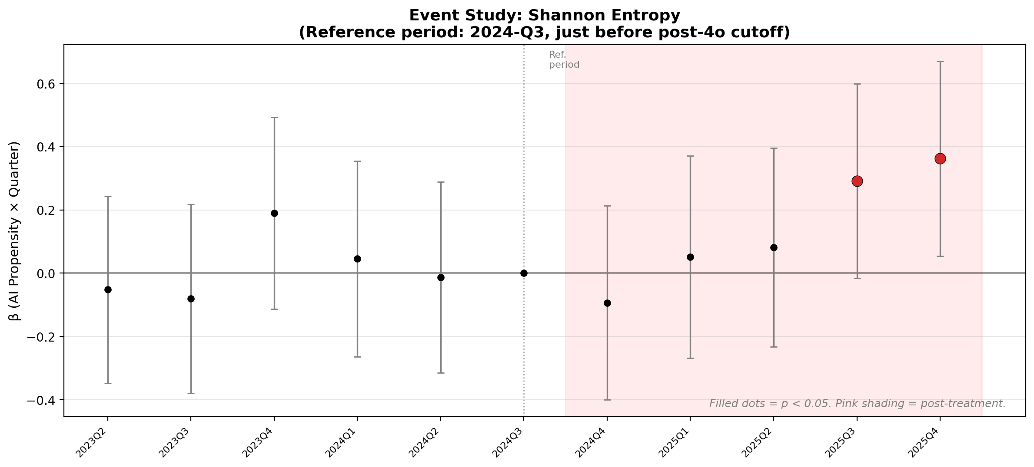
Event Study: Treatment Effect Emerges Post-4o
Propensity × quarter interactions with 2024 Q3 as reference period

Slide 10
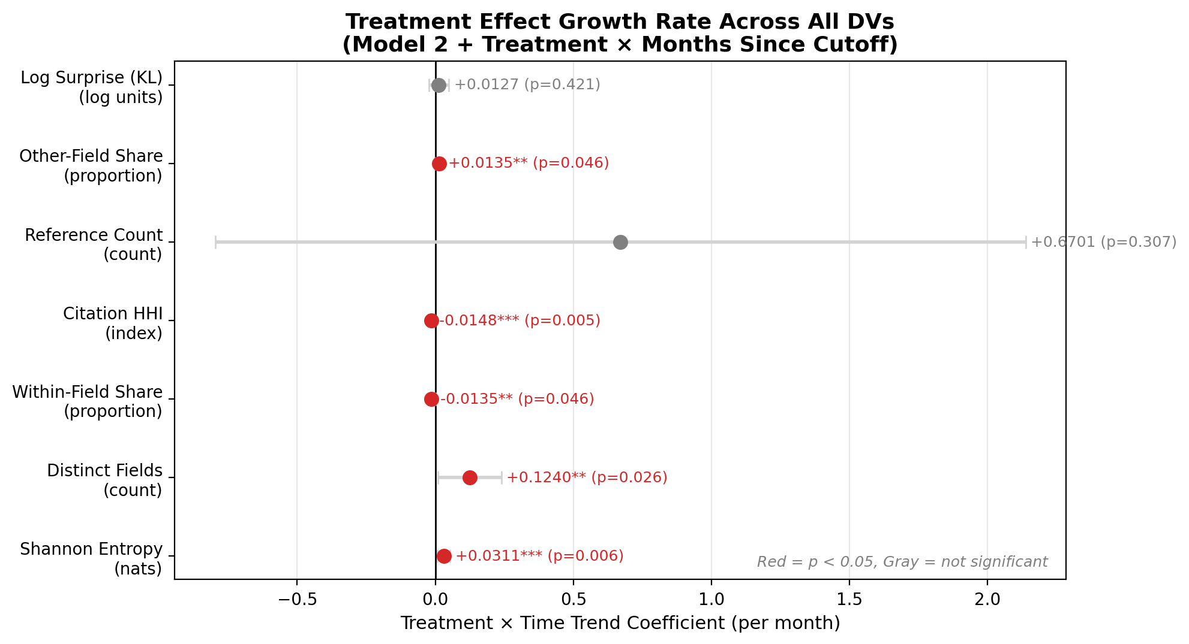
Consistent Pattern Across Diversity Measures
Treatment × trend coefficients for all 7 dependent variables (95% CIs)

Slide 11
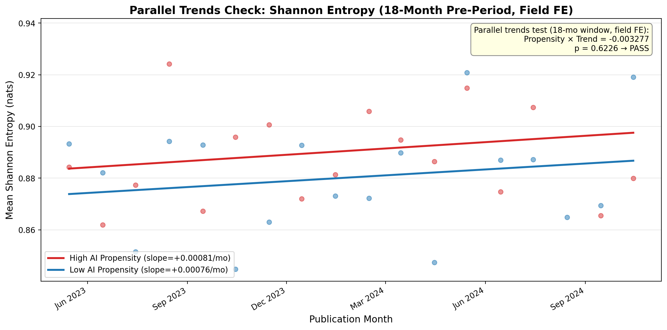
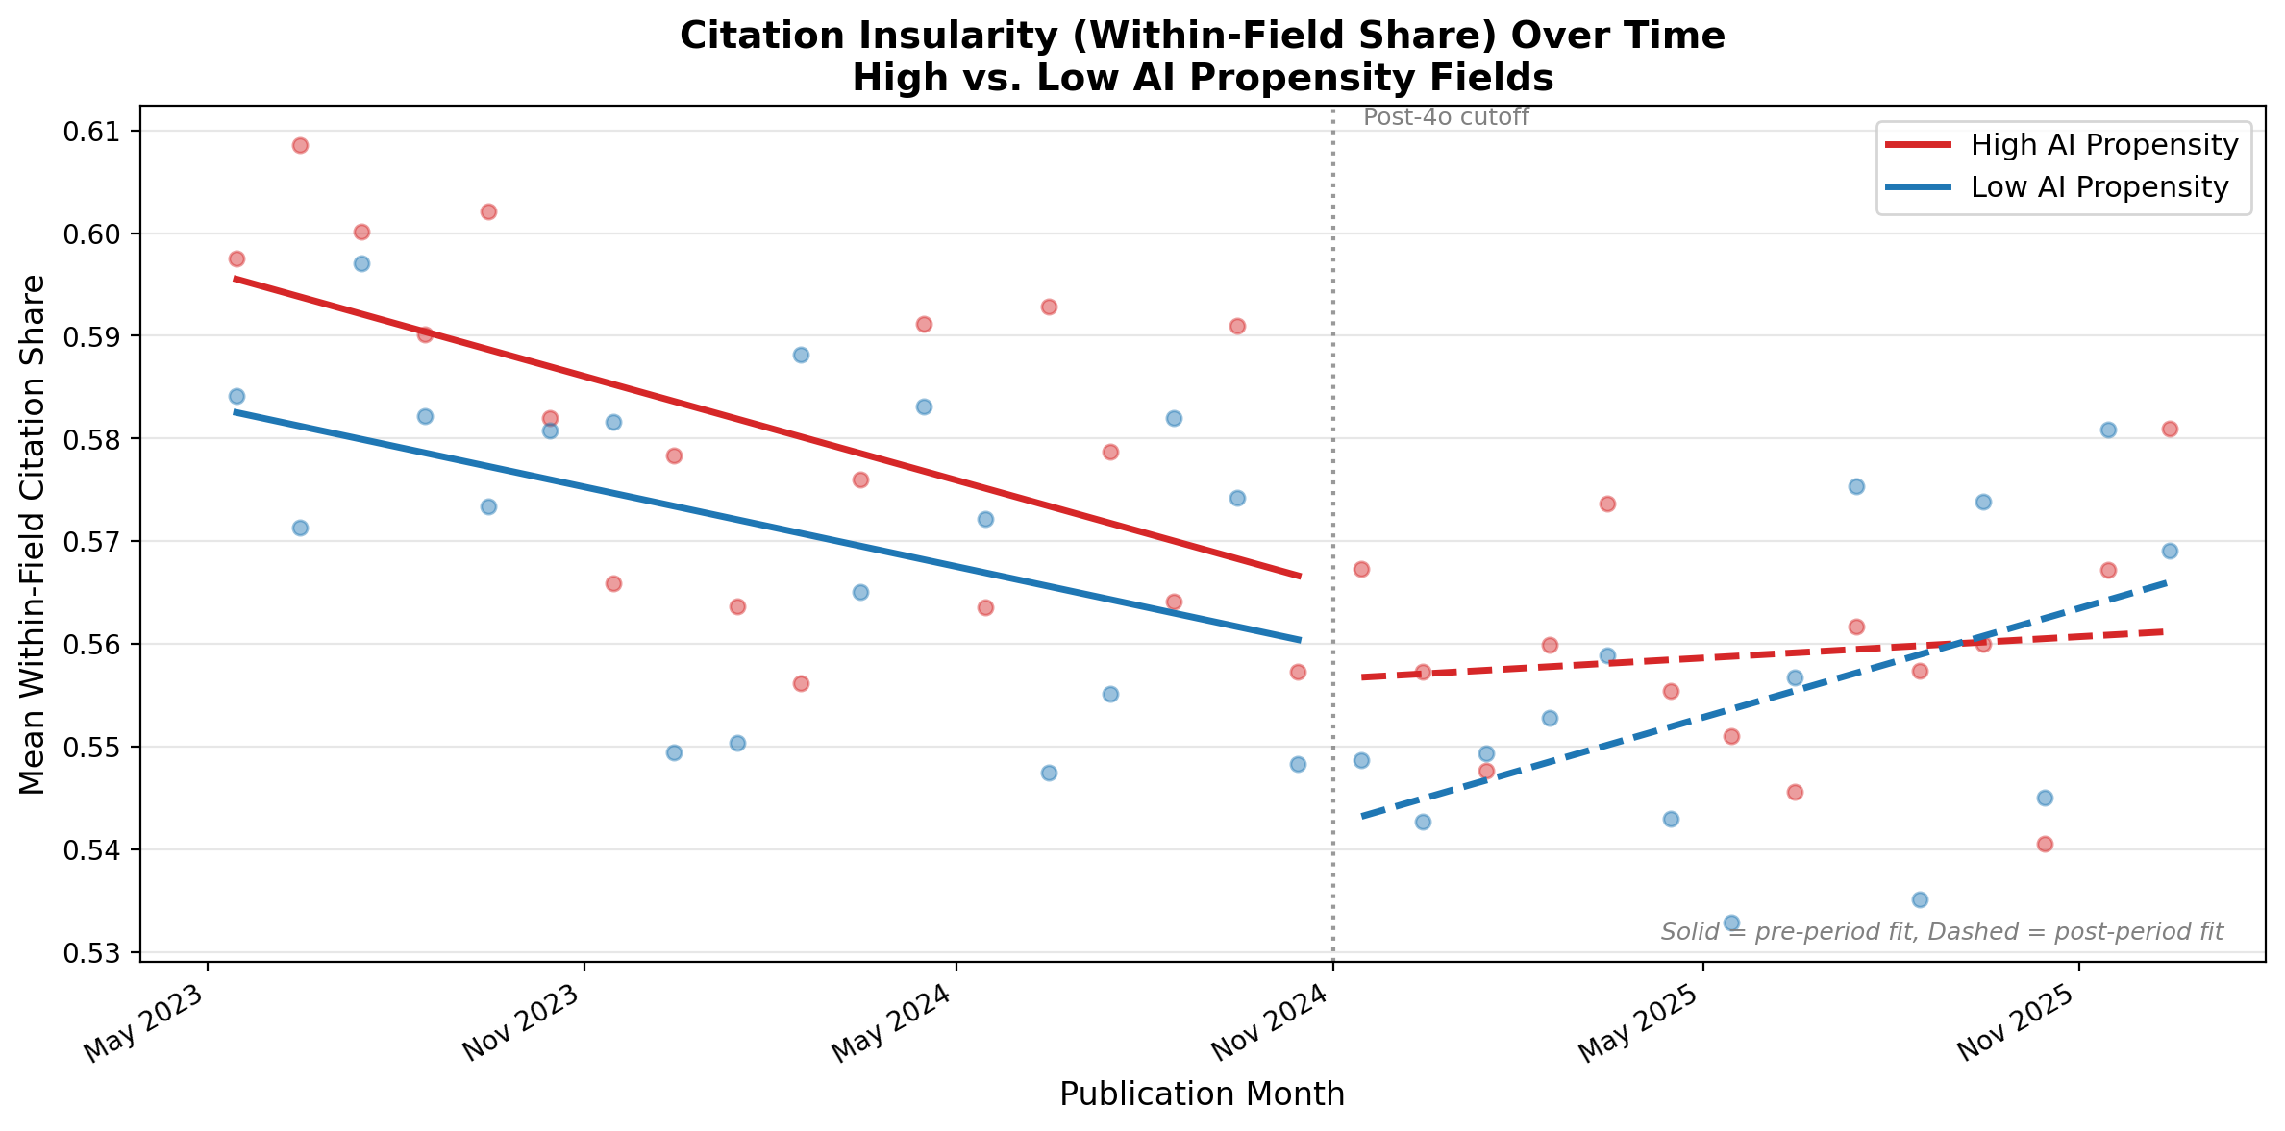
Robustness: Parallel Trends & Within-Field Share
Parallel trends pass (p = 0.56) in 18-month
pre-period with field FE
Within-field citation share declines faster
in high-propensity fields post-4o

Slide 12
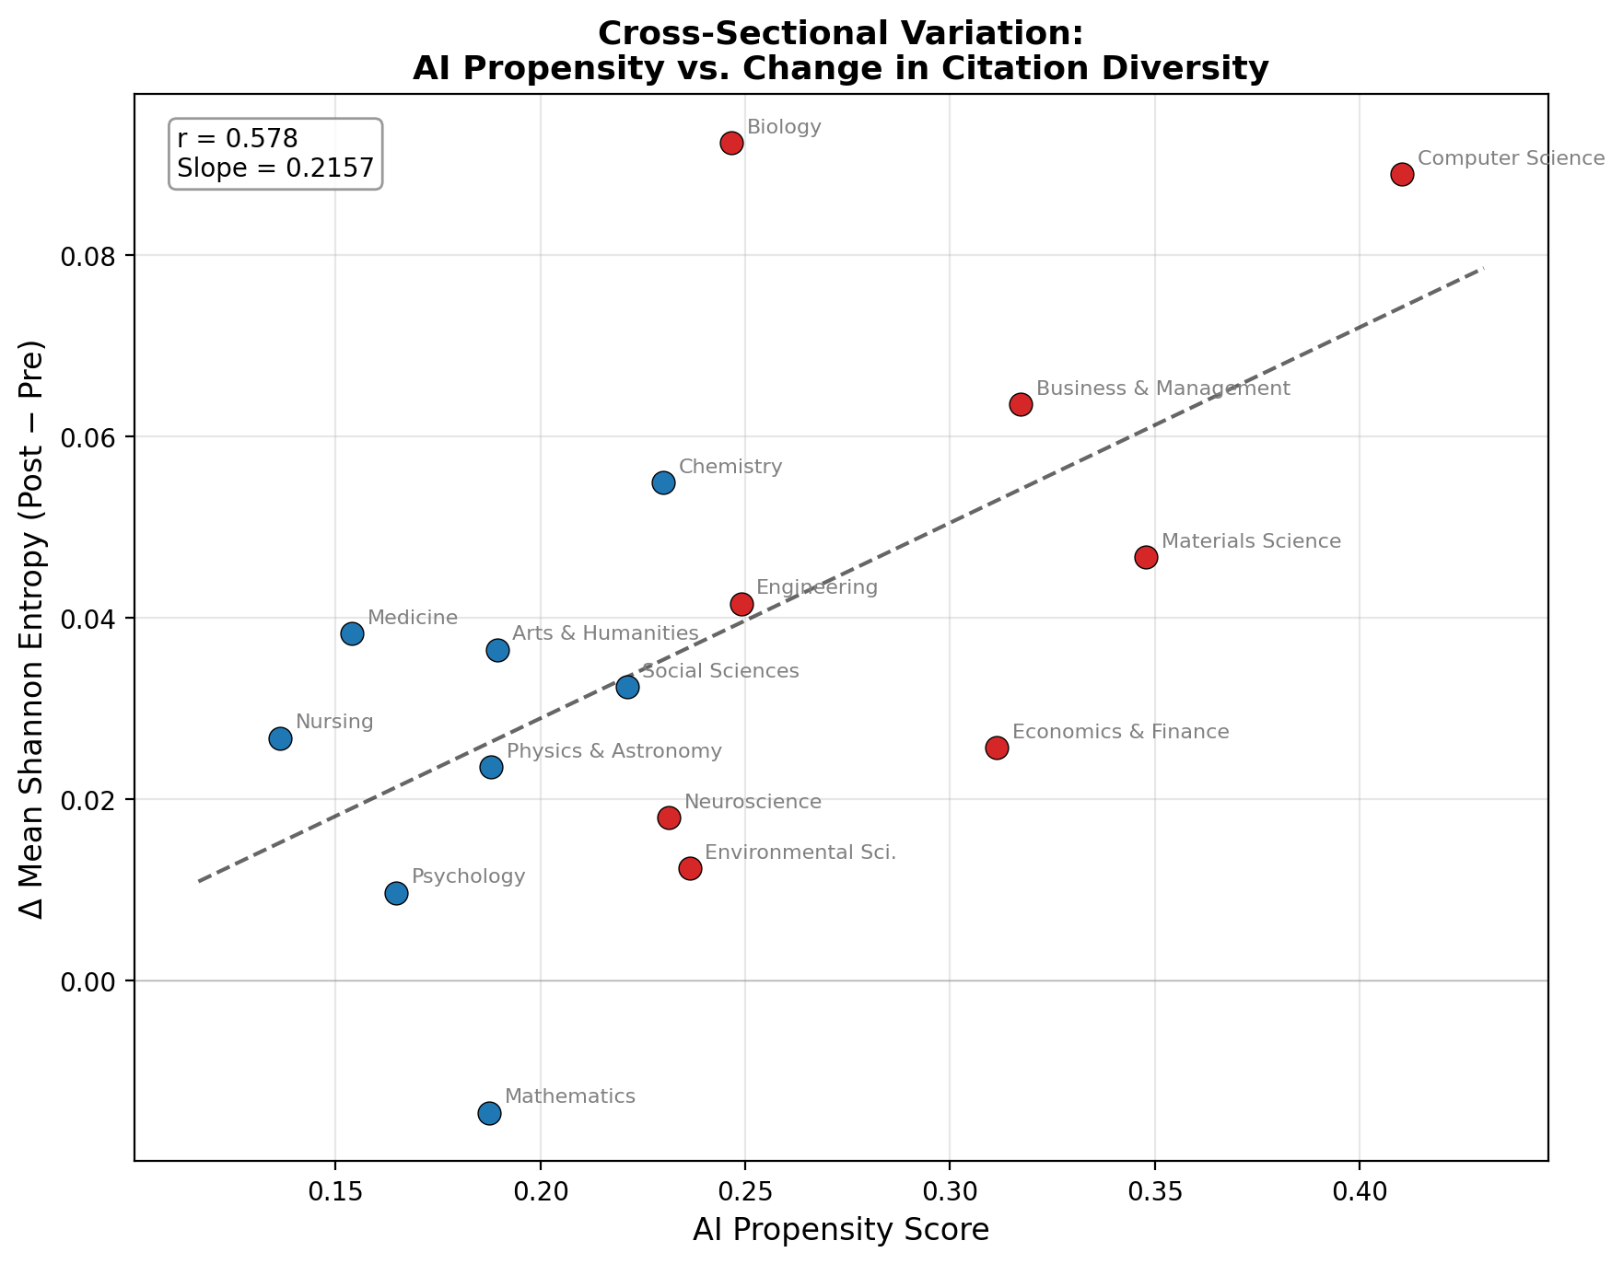
Cross-Sectional Validation
Fields with higher AI propensity saw larger increases in citation diversity (r = 0.603)

Slide 13
Limitations
1
GPT-3.5 adoption may not predict GPT-4o adoption
Propensity scores capture structural field-level receptivity to LLM assistance, not adoption of a specific model. Measured during a pre-gaming period when there was no reputational cost to AI-influenced writing.
2
Concurrent LLM releases confound the GPT-4o effect
Claude, Gemini, and Llama improved over the same period. Our estimand is best interpreted as the effect of crossing a broad AI accessibility threshold — GPT-4o was the first frontier model available for free — not the effect of one product.
3
Propensity reflects field structure, not individual behavior
We cannot distinguish whether high-propensity fields adopt LLMs because of structural workflow amenability or because of demographic composition (e.g., younger, more tech-savvy researchers). Field FE absorb level differences, but the interaction could still reflect composition.

Slide 14
Future Work
1
Do cross-disciplinary citations produce lasting impact?
Track forward citations, disruption indices (CD₅), and knowledge persistence of AI-era papers over 3–5 years. Tests whether the entropy increase we document translates into genuine knowledge integration or superficial breadth — directly engaging Hao et al.’s knowledge contraction and Kusumegi et al.’s quality decline findings.
2
Individual-level analysis
Move from field-level to author-level treatment using individual writing style shifts as a proxy for personal LLM adoption. Would allow researcher fixed effects and sharper identification of who drives the entropy increase.
3
Disentangle the mechanism
Are researchers discovering new literatures through LLM suggestions (Algaba’s channel), or does LLM-assisted writing lower the cost of integrating sources they already knew about? Experimental or survey-based designs could separate these pathways.

Slide 15
Key Takeaways
1
Citation diversification is causal
Shannon entropy increases by +0.030 nats/month in high-propensity fields post-4o (p = 0.006)
2
Effect is gradual, not a jump
Treatment × trend specification fits better than level shift — consistent with diffusion
3
Consistent across measures
Entropy, distinct fields cited, HHI, and within-field share all point the same direction
4
Complements existing literature
Hao et al. (2026) find AI contracts topic diversity; we find it expands citation breadth — different margins
Ben Heim & Adam Tuchler | University of Chicago | bheim@uchicago.edu

